Slide 1
*TRIP* WELCOME WORKSHOP

Slide 2
I AM YOUR CHALLENGE LEADER
RESPONSIBLE FOR:
BEING YOUR FIRST POINT OF CONTACT ON CAMPUS
ORGANISING GROUP FUNDRAISERS
HOLDING 1-2-1S
ARRANGING SOCIALS
HOLDING WORKSHOPS (LIKE THIS ONE)
ANSWERING ANY QUESTIONS YOU HAVE
ADD A PIC OF YOURSELF

Slide 3
ICE BREAKER
GET INTO GROUPS
WRITE DOWN 10 THINGS YOU HAVE IN COMMON
IT CAN BE ANYTHING (COURSE, AGE, TRAVEL ETC)

Slide 4
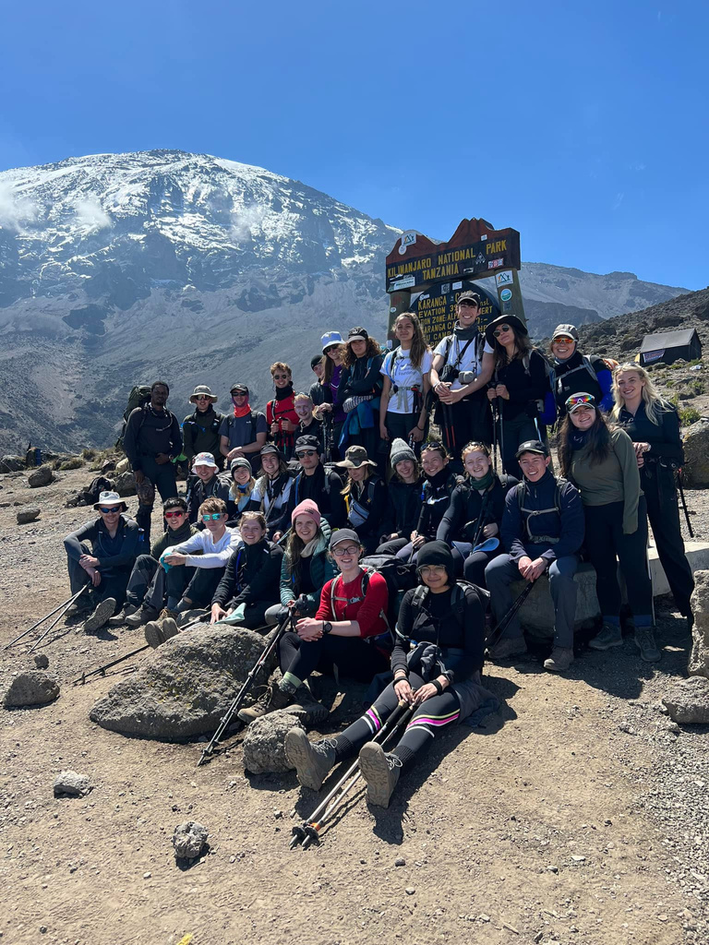
ICE BREAKER
FEED BACK TO THE GROUP THE MOST INTERESTING THING YOU HAVE IN COMMON

Slide 5
ADMIN: STAYING IN TOUCH
OPEN FACEBOOK AND SEARCH "STUDENTS AGAINST MENINGITIS"
LIKE THIS PAGE TO KEEP UP TO DATE
SEND THE PAGE A MESSAGE SO MRF KNOW WHAT UNI YOU ARE FROM

Slide 6
ADMIN: FUNDRAISING AGREEMENT
MAKE SURE YOU SIGN THIS AND RETURN IT TO ME
THIS IS A LEGAL REQUIREMENT AS YOU ARE FUNDRAISING OVER £1,000

Slide 7
GROUP ACTIVITY 1
BRAINSTORM ALL OF YOUR NETWORKS
THINK OF A FEW FUNDRAISERS THAT YOU COULD DO WITH EACH OF THESE NETWORKS
CHOOSE YOUR FAVOURITE FUNDRAISING IDEA TO SHARE WITH THE REST OF THE GROUP!

Slide 8
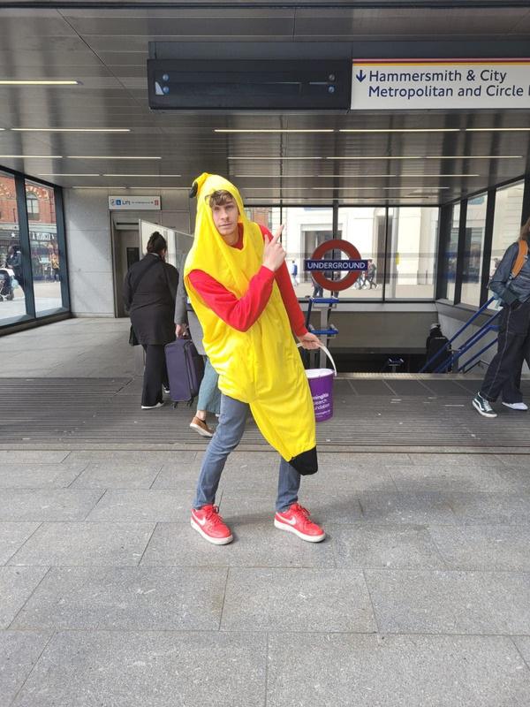
GROUP ACTIVITY 2
PICK YOUR FAVOURITE FUNDRAISER FROM WHAT YOU HAVE COME UP WITH & BEGIN PLANNING IT AS A GROUP
CONSIDER LOCATION, DATE, HOW YOU WILL RAISE DONATIONS…
THINK ABOUT ANYTHING YOU CAN ADD ON TO MAKE IT AS SUCCESSFUL AS POSSIBLE

Slide 9
NEXT STEPS
SET UP YOUR JUSTGIVING PAGE
JOIN THE TRIP GROUP CHAT
CHECK OUT THE ONLINE RESOURCES HUB
PICK UP YOUR FUNDRAISING RESOURCES
SET UP YOUR FIRST FUNDRAISER!

