Slide 1
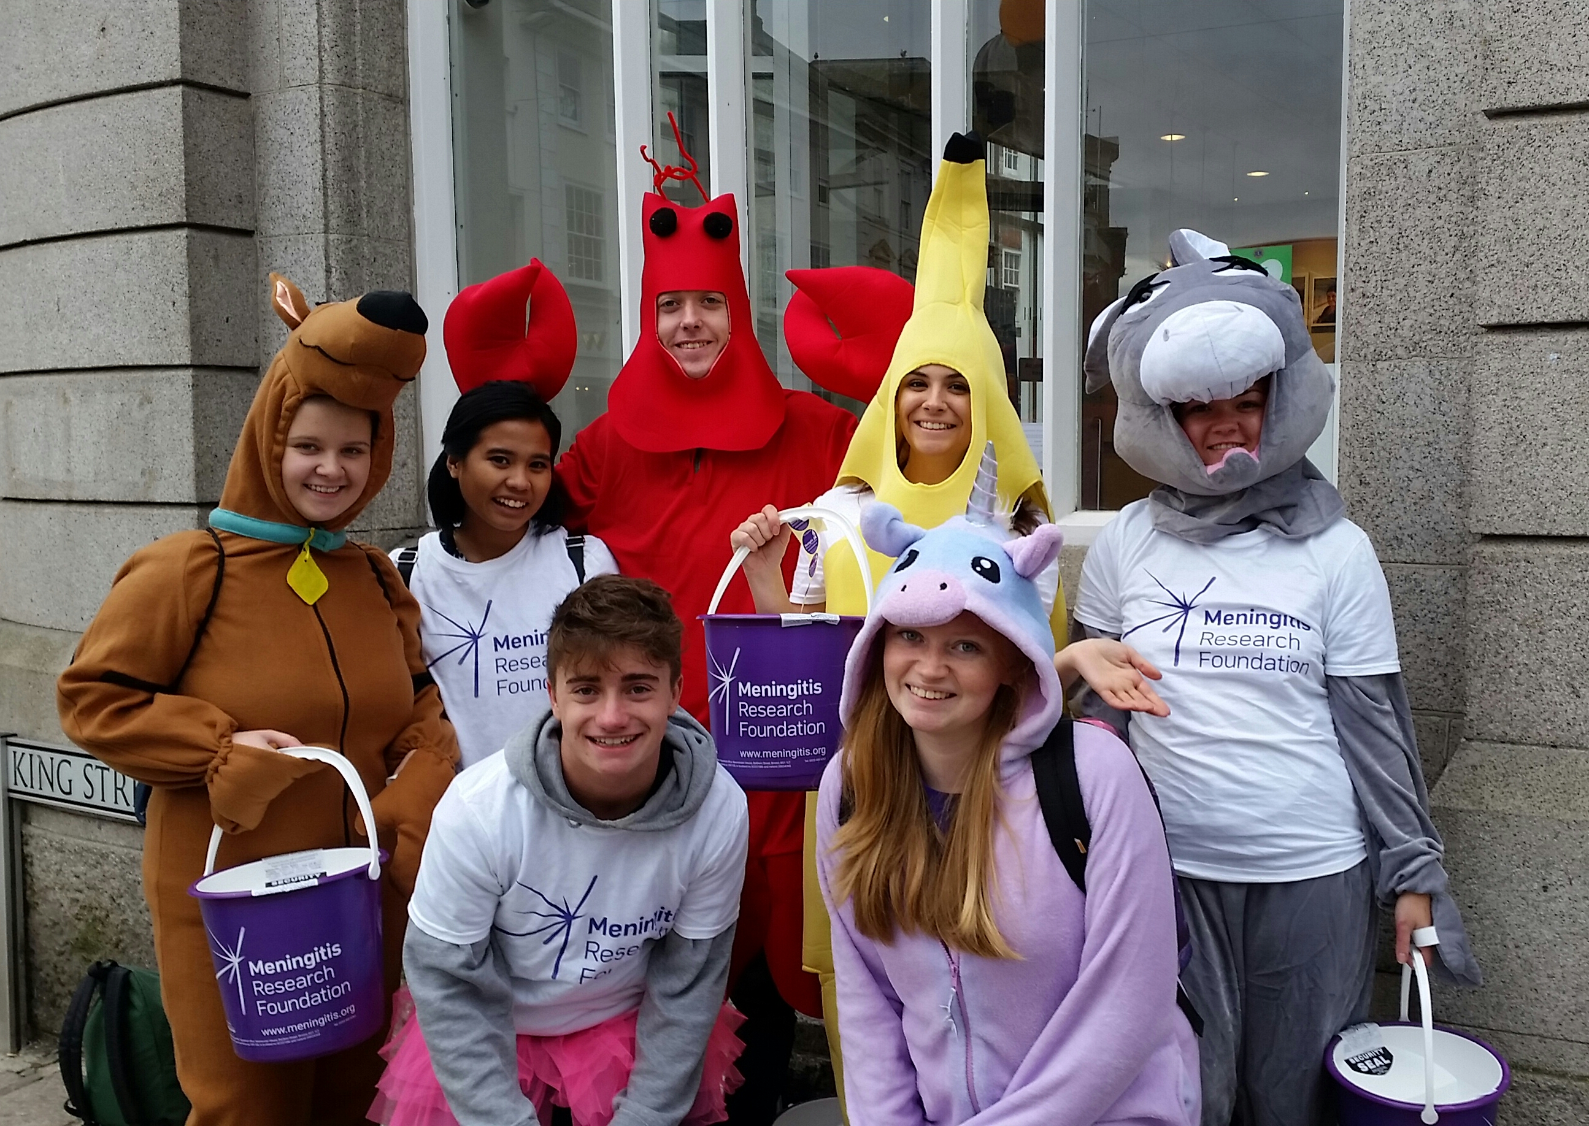
Summer
Fundraising Workshop
Notes:
Getting ready
Book a room on campus for the event, on a day that most people will be available (i.e. not on a Wednesday evening if you know lots of your team are involved in sports societies!)
Make a private Facebook event and make sure as many people attend as possible - say that you will be going through lots of really important fundraising information and so attendance is compulsory!
Look through the presentation to familiarise yourself with it, look at the notes at the bottom of each slide and for some guidance.
Print then handouts – enough copies for everyone in your team.
Deliver the workshop!
Consider also organizing a social alongside it. For example, you could go to the SU for a few drinks once the workshop has finished.

Slide 2
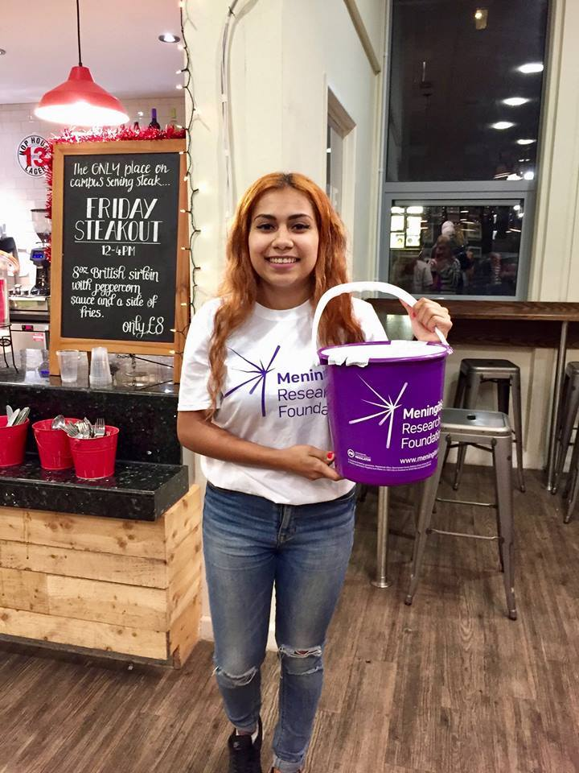
Summer Holidays
Things to do:
Keep sharing your page!
Make sure you reach the 80% and 100% milestones
Chase up any promised donations
Empty and pay in money from collection tins
Thank everyone who has supported you so far
Start training for your trek?
Look at the Summer fundraising ideas on your handout. Can you think of any others? Get into small groups and share ideas!
Notes:
Go through the ‘to do’ list and summer fundraising ideas on the handout
Get everyone into small groups – give them 5 minutes to try and think of some of their own summer fundraising ideas to add to the list

Slide 3
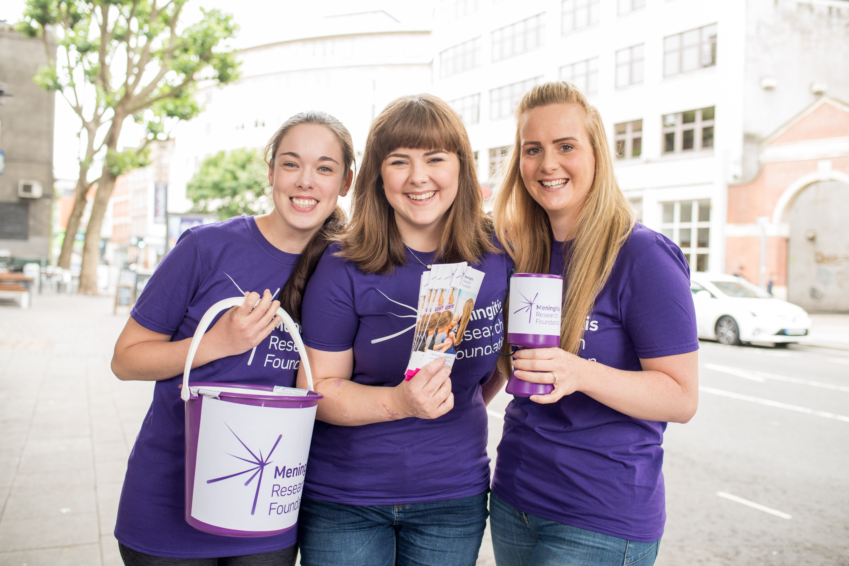
Group Activity
Get into small groups and help each other to create a plan for your remaining fundraising!
How much have you raised so far?
How much do you have left to raise?
What fundraisers have you done that worked well and which others in your team might be able to replicate?
Which summer fundraising ideas on the handout might you be able to organise for over the holidays?
Notes:
Split the group into 4 teams
Follow instructions above
Once everyone has had enough time to do this (20 mins max), move onto the next slide and get each team to pitch their event

Slide 4
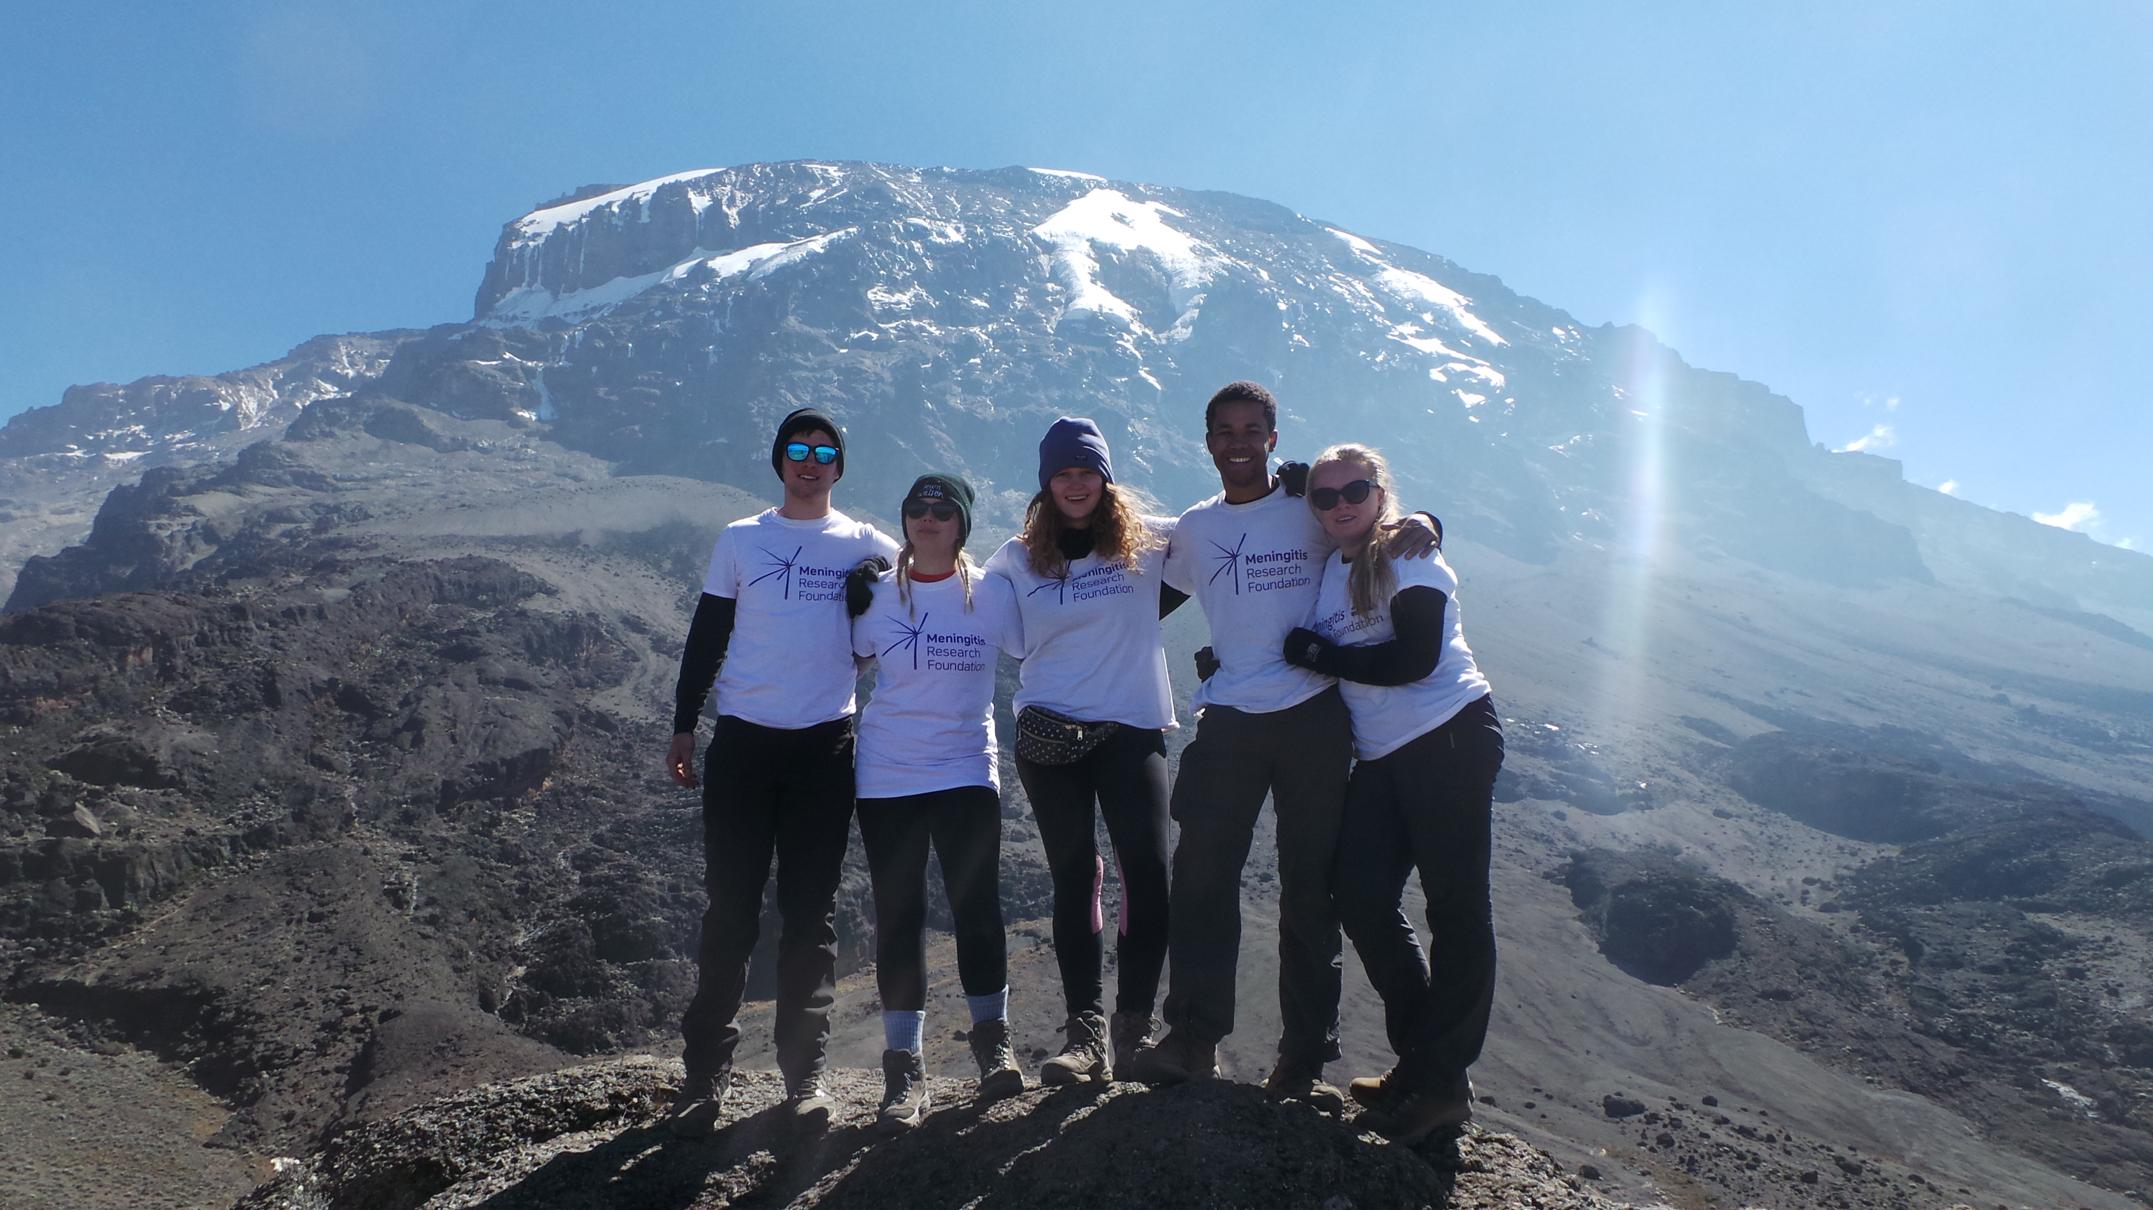
DON’T FORGET!
Your 80% milestone is on:
DATE
If you fail to meet the 80% and 100% milestones your place will no longer be confirmed and you will unable to go on the trip.
Notes:
Remind everyone of when the 80% (and ideally the 100% milestone) is
Emphasize that if you do not reach this milestone then we will not book your place and you will not be going on the trip
Also remind everyone that even if they do reach the 80% milestone and we book their place on the trip, if they do not then also reach the 100% milestone then they will not be going on the trip!
If anyone has any concerns about reaching the milestones, get them to message the Students Against Meningitis page and we can discuss their options with them

Slide 5
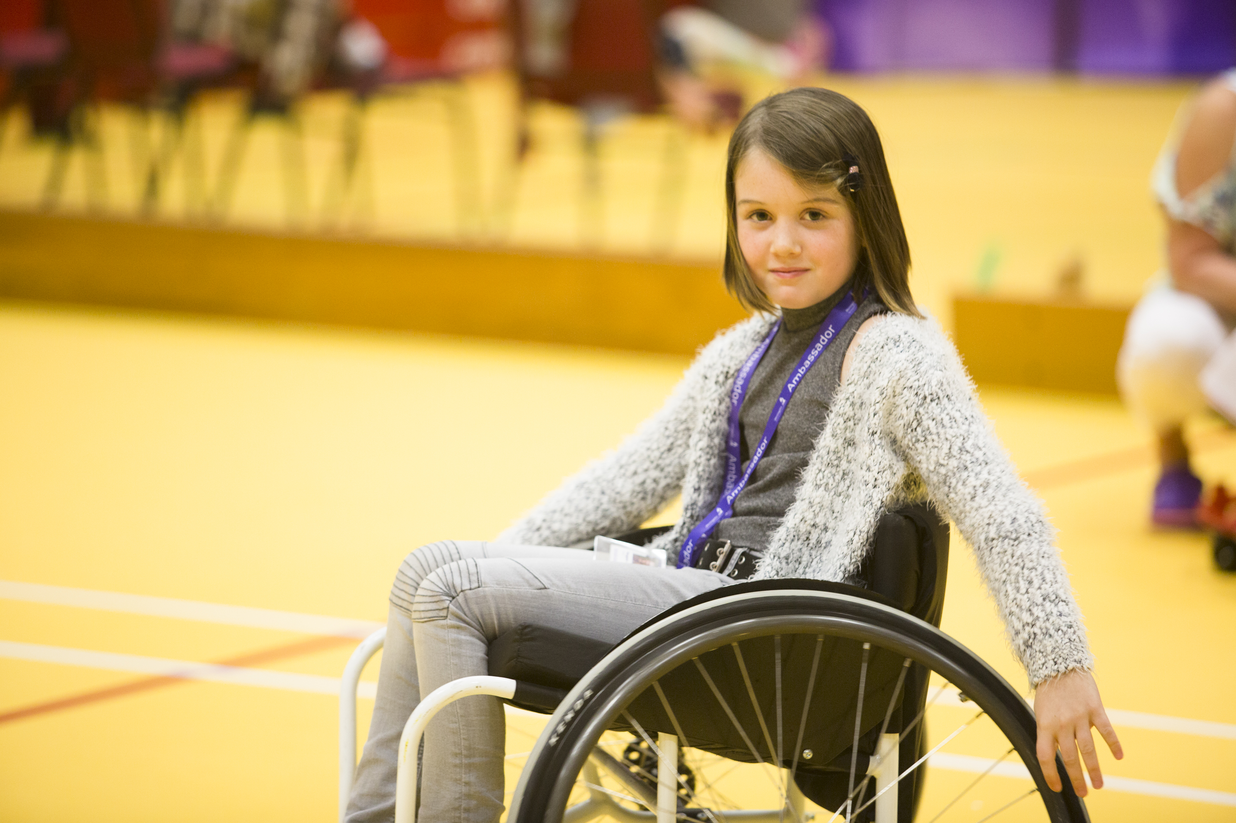
THANK YOU!
For raising and incredible
£________
Your money will have a huge impact in helping us to achieve our goal of a world free from meningitis and septicaemia by funding life-saving research and allowing us to continue to support families who have been affected by the disease.
Notes:
Add your team total (can be found on your everydayhero landing page)
Thank everyone for all of their hard work throughout the year – and let them know how valuable the money they have raised is

Slide 6
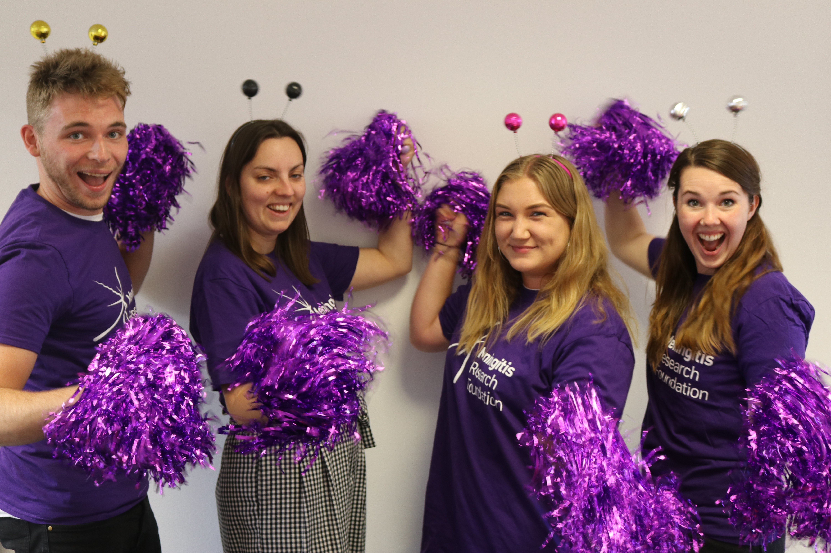
GOOD LUCK
We hope you enjoy your adventure!
Notes:
Remind everyone about any important trip information – such as getting all their vaccinations and kit sorted ASAP (Choose a Challenge can answer any questions about this that you may have)
We wish you the best of luck and hope you have an incredible time on your trip!

