Slide 1
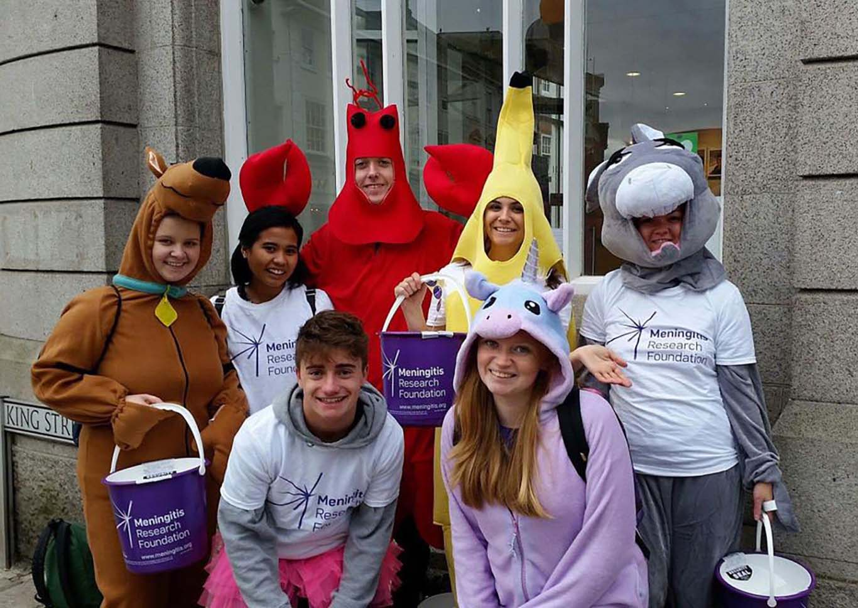
Summer Fundraising workshop

Slide 2
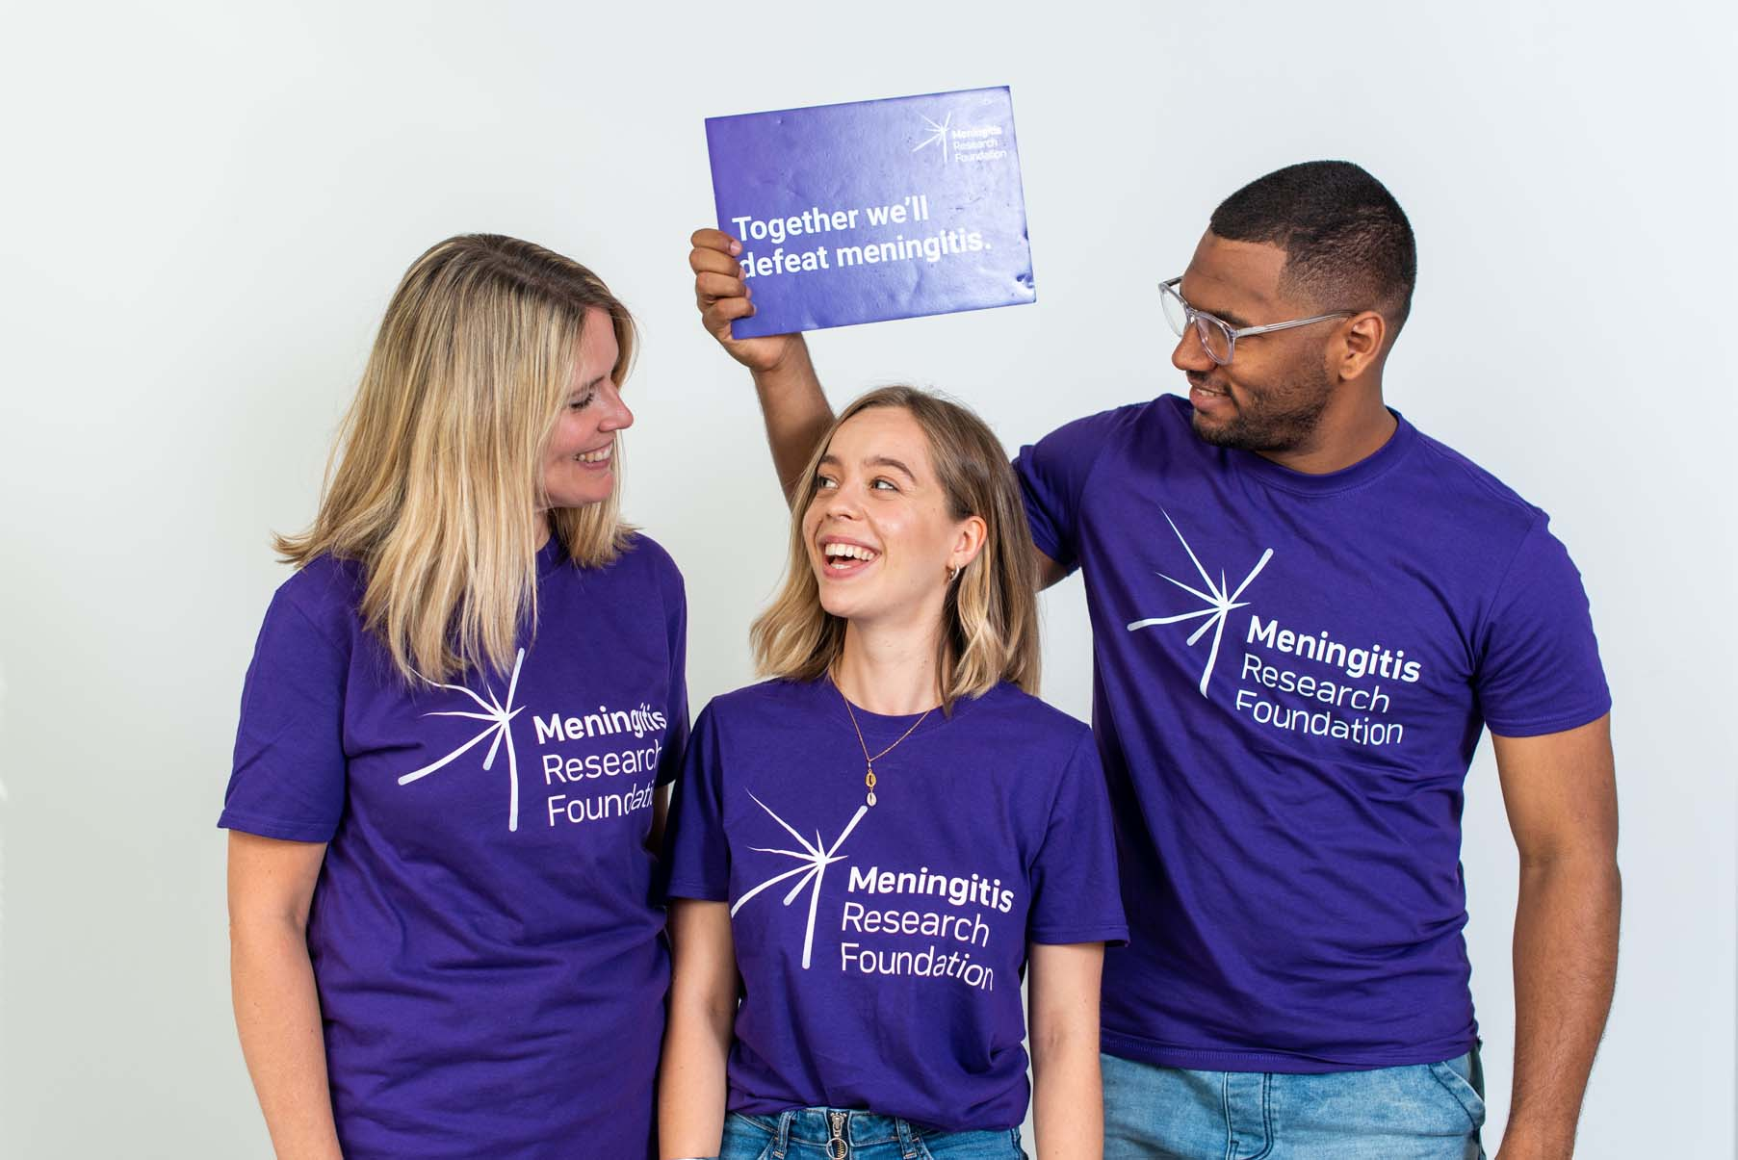
Group activity
Everyone open the team jamboard (your leader will have sent you a link!)
In blue – put down any fundraising ideas you can do whilst government restrictions are in place (e.g selling clothes on depop)
In yellow – put down any ideas which could be altered to do under restrictions (e.g a pub quiz could become an online quiz!)
In green put any ideas down which can’t be done now but you can plan towards (e.g a bagpack which you could book in now!)
Go around the group and each pick one idea from each colour to do/plan this month!

Slide 3
It’s Quiz Time!
Pencils at the ready – how much do you know about MRF?

Slide 4
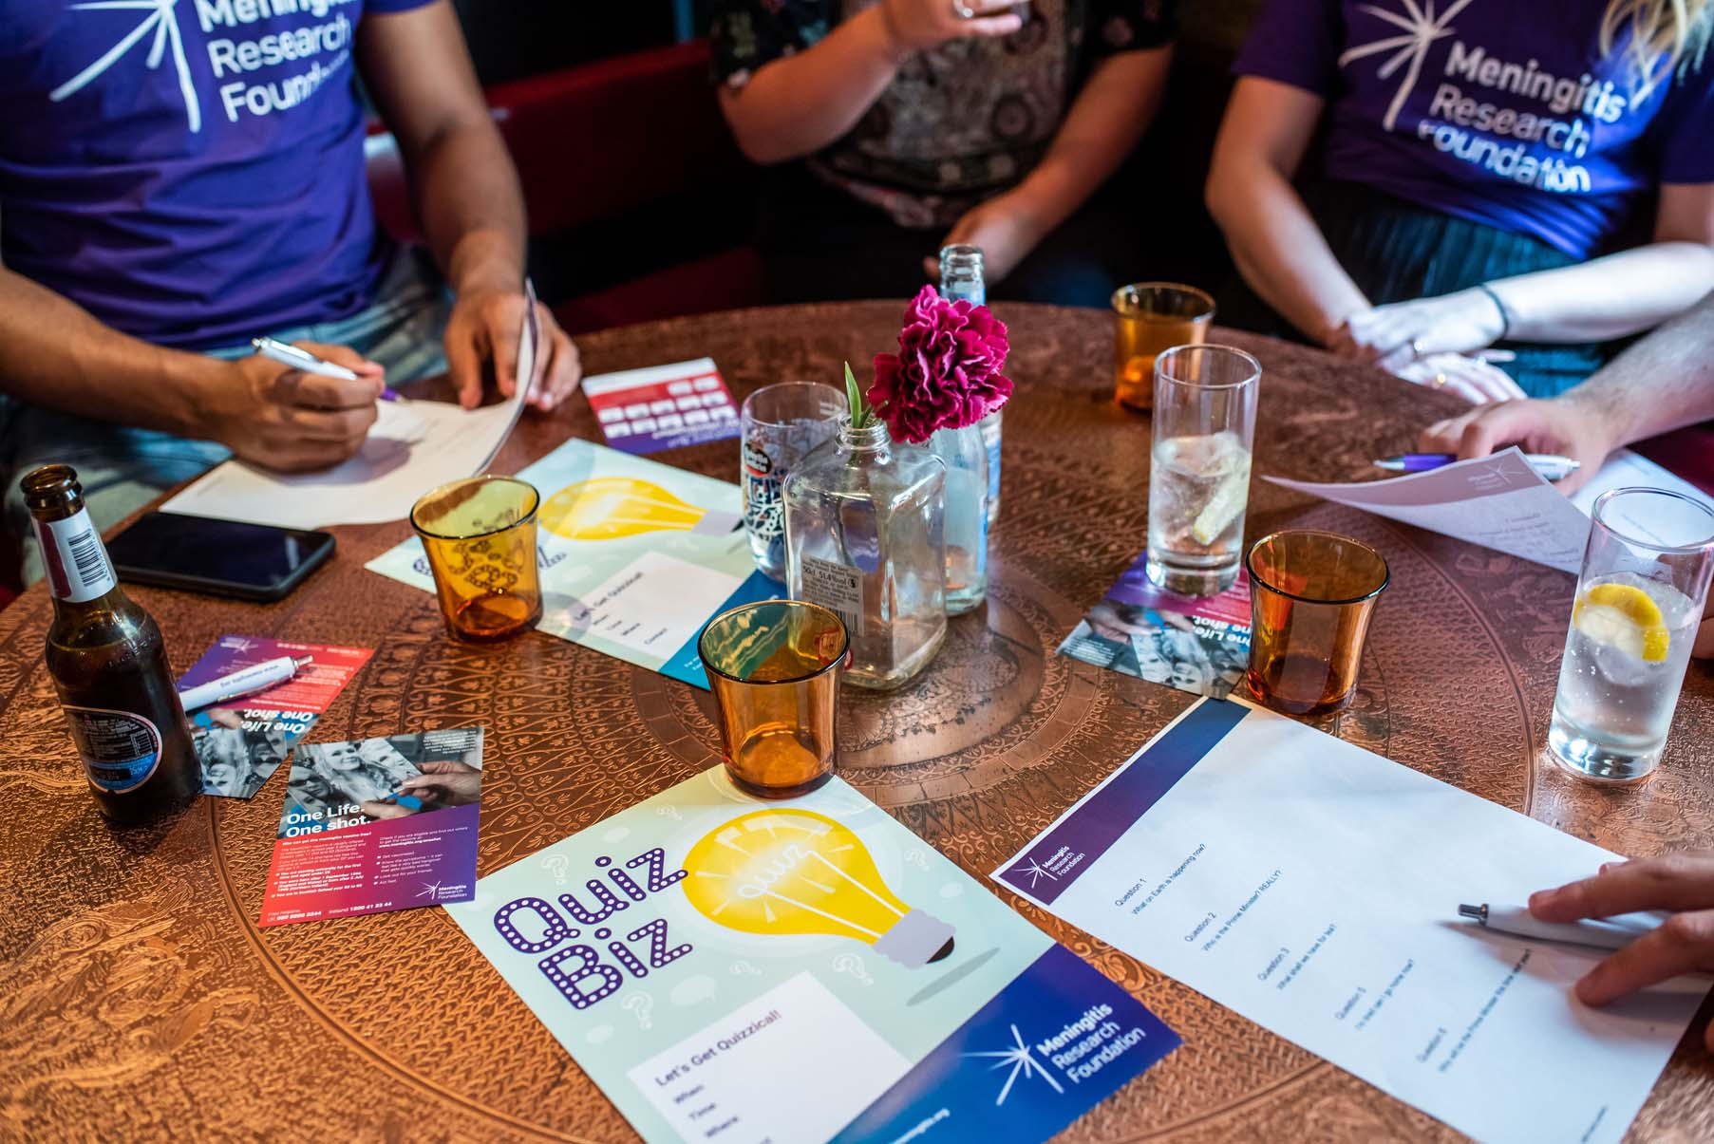
20 questions about MRF
How many did you get right?
Remember the more you know about MRF and the more you shout about our work the more you can raise!
To keep up-to-date with everything MRF do – keep an eye on the website – www.meningitis.org
And follow MRF on Facebook, Instagram, Twitter & Linkedin!

Slide 5
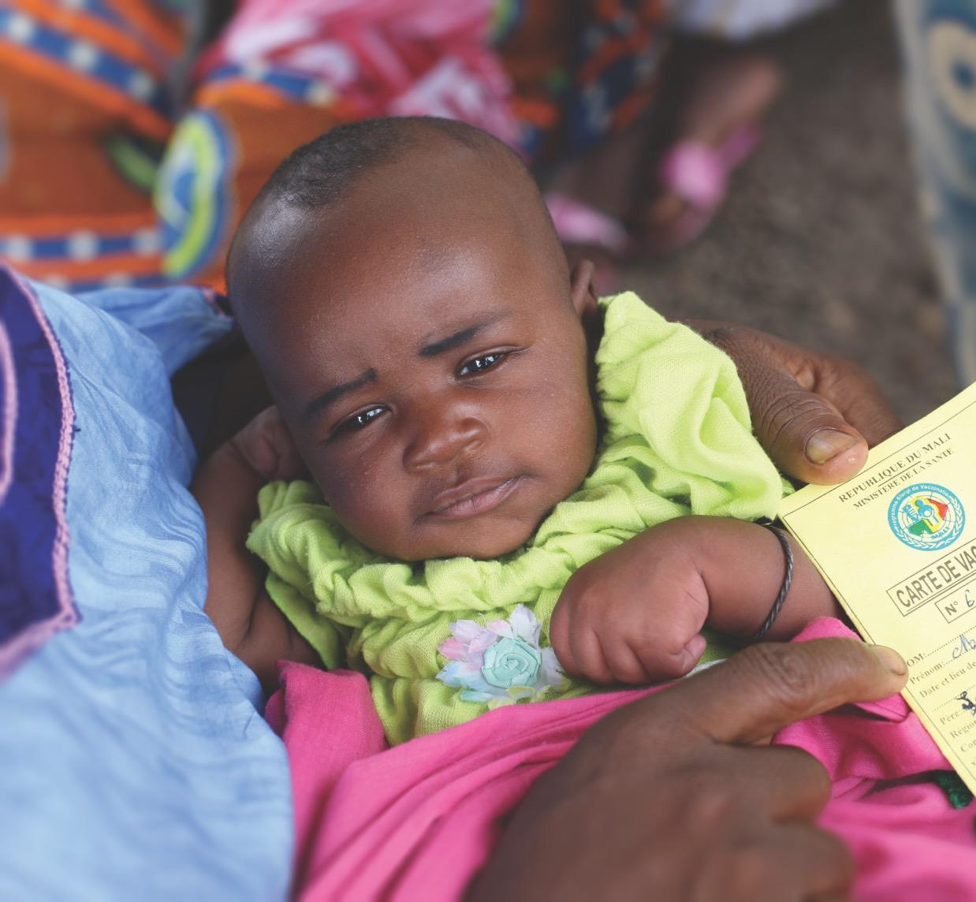
Things to do
For your fundraising:
Keep sharing your JustGiving page
Keep planning fundraisers – for now and after restrictions are lifted
Stuck for ideas – speak to your Challenge Leader or email students@meningitis.org
Virtual fundraising opportunities:
Grab a friend & sign up to Mates for MRF
Know a football fan? – get them signed up to goalgiving

Slide 6
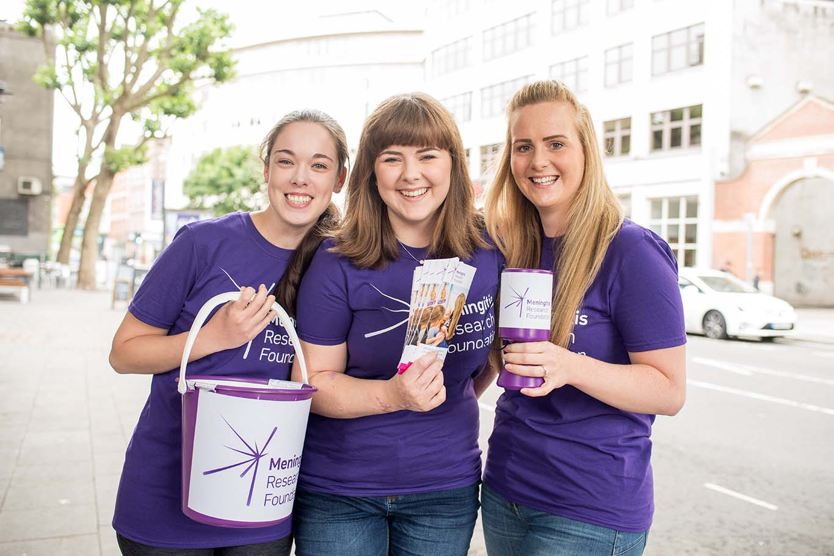
Thank you for raising £_____ towards MRF’s vital work!

